Slide 1
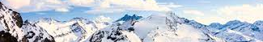
Navigating the Summit
Transformative Insights for Big Mountain Resort
Notes:
Ladies and gentlemen, welcome to 'Navigating the Summit: Transformative Insights for Big Mountain Resort.' Today, we embark on a journey into the heart of data-driven decision-making, exploring how advanced analytics can elevate the strategic landscape for our esteemed resort. Big Mountain stands at a crossroads, and our mission is to unravel the secrets hidden within the data, providing actionable insights that will shape the future of our operations. From pricing strategies to facility enhancements, each piece of information uncovered is a beacon guiding us towards sustainable success. So, let's delve into the peaks of possibilities, armed with the power of analytics, and navigate the summit together.

Slide 2
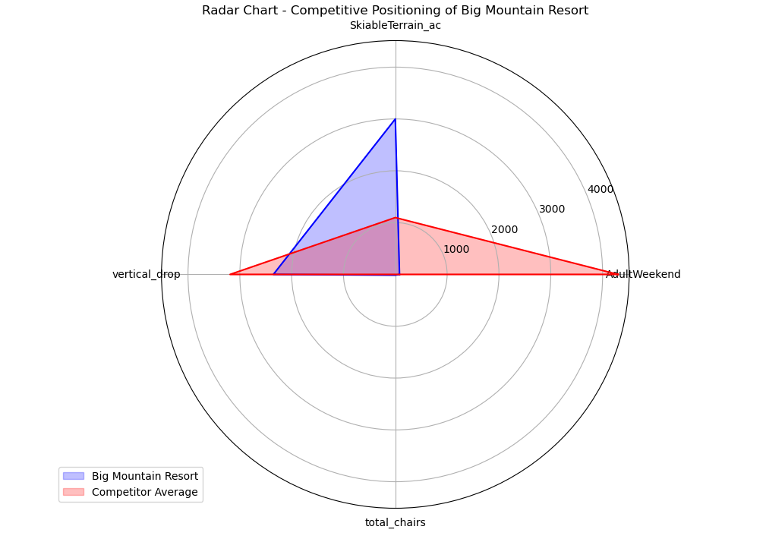
CHALLENGES &
OPPORTUNITIES
Notes:
The farther the blue area extends beyond the red area, the more Big Mountain Resort outperforms the competitors in those particular features.
Horizontal Extension (Red): Indicates that, on average, competitors have higher values in the features represented by the horizontal axis.
Vertical Extension (Blue): Indicates that Big Mountain Resort has a higher value in the feature(s) represented by the vertical axis.
AdultWeekend:
Big Mountain Resort (Blue): The length of the blue line on the 'AdultWeekend' axis indicates that Big Mountain Resort's weekend ticket price for adults is higher than the average of its competitors.
Competitor Average (Red): The length of the red line on the same axis represents the average weekend ticket price for adults across all other resorts.
SkiableTerrain_ac:
Big Mountain Resort (Blue): The length of the blue line on the 'SkiableTerrain_ac' axis shows that Big Mountain Resort has a larger skiable terrain area compared to the average competitor.
Competitor Average (Red): The red line on the same axis represents the average skiable terrain area for all other resorts.
Vertical Drop:
Big Mountain Resort (Blue): The length of the blue line on the 'vertical_drop' axis indicates that Big Mountain Resort has a greater vertical drop compared to the average competitor.
Competitor Average (Red): The red line on the same axis represents the average vertical drop for all other resorts.
Total Chairs:
Big Mountain Resort (Blue): The length of the blue line on the 'total_chairs' axis shows that Big Mountain Resort has more total chair lifts compared to the average competitor.
Competitor Average (Red): The red line on the same axis represents the average number of total chair lifts for all other resorts.

Slide 3
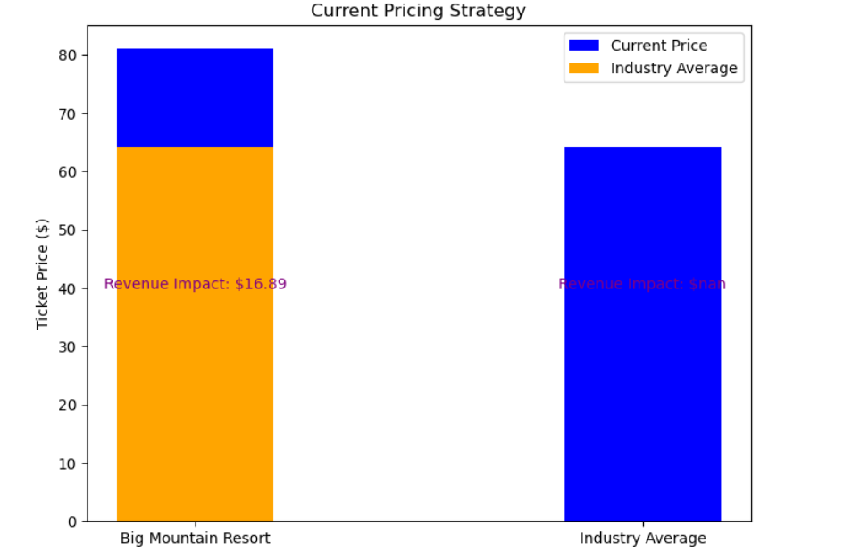
Current Pricing Strategy
Revenue Impact: Big Mountain Resort's pricing strategy is generating higher revenue compared to the industry average.
Competitiveness: The revenue impact analysis shows that this strategy is contributing to increased revenue.
Notes:
Big Mountain Resort's decision to set a higher ticket price than the industry average has resulted in a positive revenue impact. Despite being priced higher, the resort is successfully capturing a customer segment willing to pay a premium for its offerings. This strategy aligns with the goal of maximizing revenue.
Revenue Impact: The purple text indicates the revenue impact of Big Mountain Resort's pricing strategy compared to the industry average. The calculated revenue impact is determined by the difference between Big Mountain Resort's average ticket price and the industry average. A positive value suggests that Big Mountain Resort's pricing strategy is generating higher revenue compared to the industry average.
Competitiveness: The purple text emphasizes that Big Mountain Resort is positioned as a higher-priced option in the market. While this may seem counterintuitive, the revenue impact analysis shows that this strategy is contributing to increased revenue.

Slide 4
Strategic Recommendations
Ticket Price Adjustment: Implement a strategic ticket price increase to better align with the value Big Mountain Resort provides and reflect its positioning in the marketplace.
New Chair Lift Addition: Consider the addition of a new chair lift as a potential avenue for growth, leading to increased revenue and heightened visitor satisfaction.
Notes:
The primary recommendation is to adjust ticket prices strategically, with additional consideration for the potential benefits of adding a new chair lift. These adjustments aim to enhance Big Mountain Resort's competitiveness, increase revenue, and deliver an exceptional experience to visitors on the snowy slopes. Ongoing analysis and adjustments are encouraged to ensure continued success in the ever-evolving landscape of alpine hospitality.

Slide 5
Key Findings
Current Positioning
Modeling Insights
New Chair Lift Operating Cost
Data Limitations
Notes:
Current Positioning: Big Mountain Resort is currently charging below its potential, with ticket prices comparable to a bygone era—modest and undervalued.
Modeling Insights: The data-driven model recommends a ticket price increase that would not only enhance the visitor experience but also position Big Mountain Resort as an upper-tier ski resort.
New Chair Lift Operating Cost: While the addition of a new chair lift contributes to operational expenses, the impact is manageable when viewed in the context of each visitor purchasing an average of five-day tickets.
Future Scenarios: The modeled scenarios, particularly the one involving the addition of a chair lift, present intriguing plotlines for growth, akin to different story arcs in a film series.
Data Limitations: The analysis faced constraints due to the absence of detailed cost information and a broader range of price data for comparable resorts, creating blind spots that warrant further exploration.

Slide 6

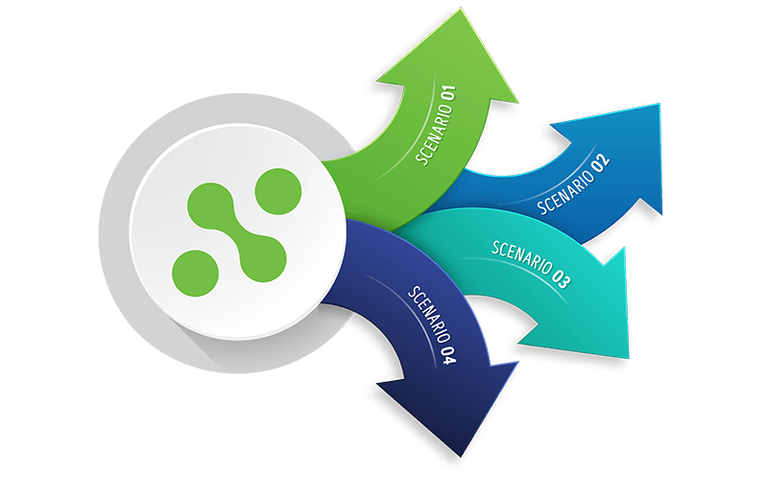
Modeling Results & Analysis
Model Selection
Model Training and Evaluation
Model Interpretation:
What influences ticket price?
Scenario Modeling
Notes:
Model Selection:
Chose a RandomForestRegressor for its flexibility and ability to capture complex relationships in the data.
Model Training and Evaluation:
Split the data into training and testing sets.
Trained the model on the training set and evaluated performance using cross-validation.
Assessed model accuracy with metrics such as mean absolute error.
Model Interpretation:
Interpreted feature importances to understand which features influence ticket prices the most.
Scenario Modeling:
Explored scenarios by modifying specific features to understand their impact on ticket prices and revenue.
Provided insights for potential changes in runs, vertical drop, total chairs, and snow making.

Slide 7
Current Pricing Evaluation
Key Features Impacting Prices
Current ticket price: $81
Model suggests potential for an increase, as it's below the predicted supportable value.
Identified influential features:
Vertical drop
Snow making area
Total number of chairs
Fast quads
Runs, longest run length
Trams, skiable terrain area
Notes:
Our modeling indicates that this price is currently below the predicted supportable value. Let's explore potential adjustments.
Understanding the key features influencing ticket prices is crucial for strategic decision-making. Here are the features that significantly impact pricing. (list them)

Slide 8
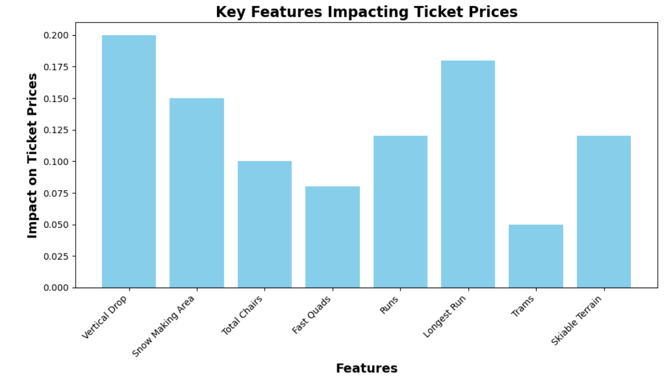
Notes:
Analyzing these features provides insights into the factors that play a pivotal role in determining ticket prices. By delving into each feature's impact on pricing, we uncover valuable information that guides strategic decision-making. Here are key insights derived from the analysis:
Vertical Drop Significance:
The vertical drop is a prominent factor influencing ticket prices. Resorts with a substantial vertical drop tend to command higher prices, reflecting the perceived value of longer and more thrilling descents.
Snow Making Area and Skiable Terrain:
The extent of snow making area and skiable terrain emerged as crucial contributors. Resorts equipped with extensive snow making capabilities and vast skiable terrain often position themselves as all-season destinations, attracting visitors with diverse skiing preferences.
Total Chairs and Fast Quads Impact:
The number of total chairs and availability of fast quads significantly impact pricing. Resorts boasting efficient chairlift infrastructure are likely to provide better accessibility to slopes, enhancing the overall visitor experience and justifying higher ticket prices.
Runs and Longest Run Length:
The number of runs and the length of the longest run play essential roles. Resorts with a variety of runs and long, captivating trails appeal to a broader audience, influencing pricing strategies to reflect the diverse offerings.
Unique Amenities like Trams:
Unique amenities such as trams contribute to the resort's distinctiveness. While trams may not be widespread, their presence enhances the overall resort experience, potentially supporting higher ticket prices.
Scenario Analysis Impact:
The scenario analysis, including run closures and facility expansions, offers actionable insights into strategic decision-making. It highlights the delicate balance between cost implications and potential revenue gains, aiding in the identification of optimal scenarios for business growth.
These insights not only reveal the quantitative impact of specific features but also provide a qualitative understanding of how our resort can differentiate in the competitive market. Armed with this knowledge, you can make informed decisions to optimize pricing strategies, enhance visitor experiences, and ultimately elevate the positioning of the resort in the broader skiing industry.

Slide 9
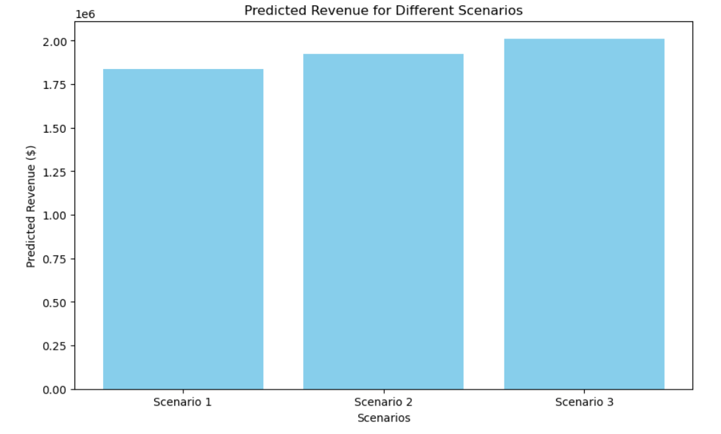
Notes:
Let’s explore the potential impacts of strategic decisions on ticket prices and revenue. Our model has meticulously evaluated various scenarios to provide actionable insights for Big Mountain Resort. Next, we will delve into each scenario, examining its profound effects on ticket prices and revenue. Through visual representations of our model predictions, we'll uncover the intricate dynamics at play. Additionally, we'll shine a spotlight on the key variables that act as driving forces behind the recommended changes. Let's begin and unravel the strategic opportunities these unveil for Big Mountain Resort.

Slide 10
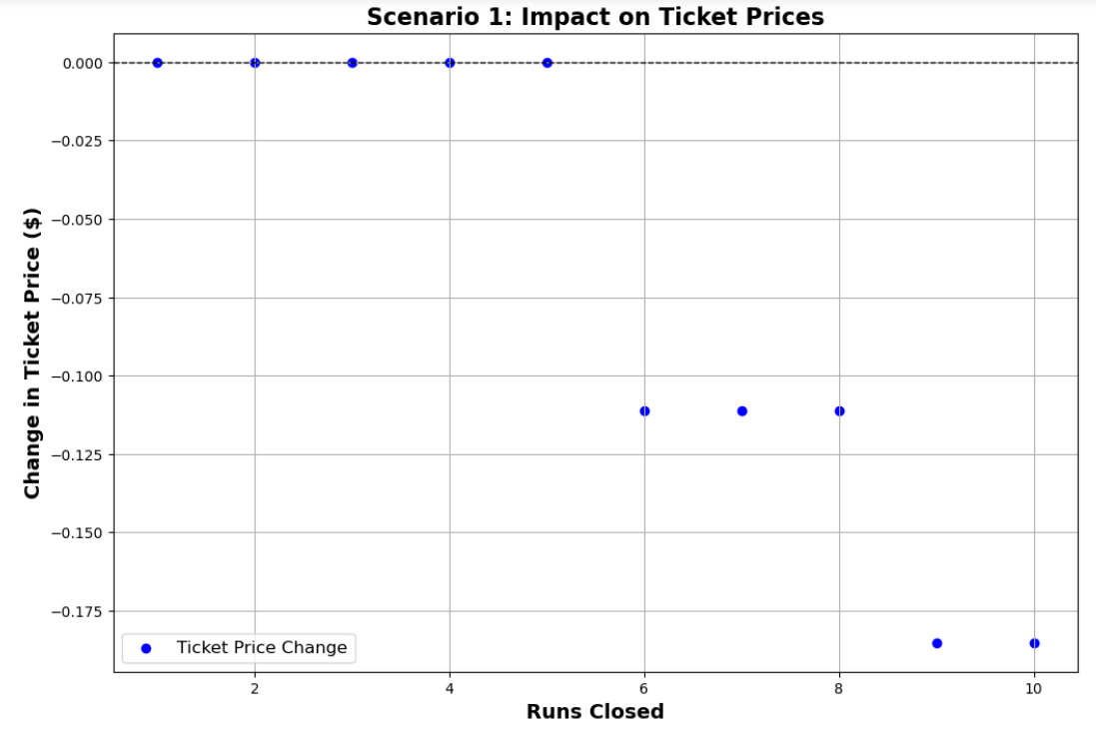
Notes:
In Scenario 1, the model assessed the impact of closing varying numbers of runs on Big Mountain Resort's predicted ticket prices. The baseline prediction for the initial ticket price at the resort was $86.96. Surprisingly, the model indicated that closing runs within the specified range did not result in a substantial change in the predicted ticket price, with minimal to no increase observed. Even when closing a higher number of runs, the largest decrease in the predicted ticket price was only $0.19. This insight suggests that the strategy of closing runs within this range may not significantly impact the model's support for a ticket price increase. Further exploration of alternative scenarios is recommended to identify more impactful strategies for enhancing revenue.

Slide 11
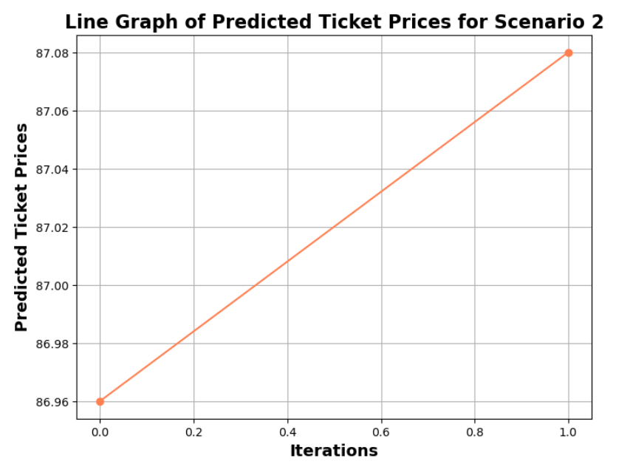
Notes:
In Scenario 2, we explore the ramifications of Big Mountain Resort's expansion and enhancement initiatives, which involve adding a new run, increasing the vertical drop by 150 feet, and installing an additional chair lift. Our model predicts a positive impact on ticket prices, with an increase of $0.11, translating to an expected revenue boost of $194,444 over the season. The accompanying line graph visually depicts the revenue changes across different iterations of Scenario 2, emphasizing the correlation between the extent of changes made and the resulting financial outcomes. This analysis sheds light on key variables influencing the predicted changes, providing valuable insights for strategic decision-making regarding the resort's offerings.

Slide 12
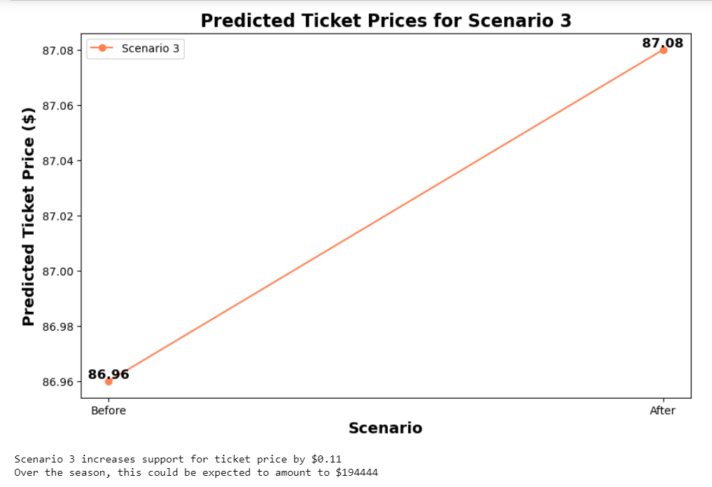
Notes:
In Scenario 3, where Big Mountain Resort enhances its facilities by adding a run, increasing the vertical drop, installing an additional chair lift, and expanding snow-making coverage, the model predicts a ticket price increase from $86.96 to $87.08, resulting in a supportable ticket price boost of $0.11. Over the season, this adjustment could potentially lead to an estimated revenue increase of $194,444. The line graph visually illustrates the predicted ticket prices for the "Before" and "After" states, showcasing the positive impact of the proposed enhancements on ticket pricing.

Slide 13
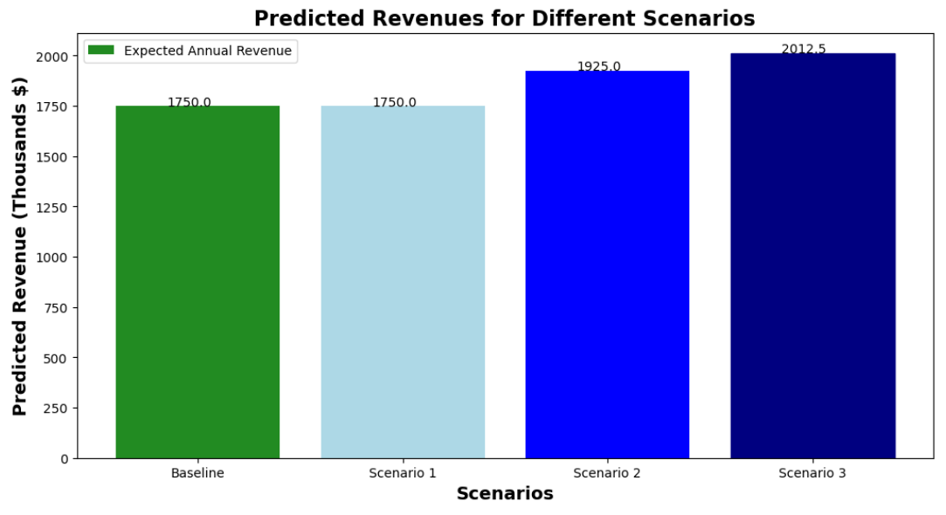
Summary
Notes:
Scenario 1 (Close up to 10 least used runs):
Feature Change: Number of runs closed.
Impact: Closing 1-5 runs showed no difference, while closing 6 or more runs led to a significant drop in predicted ticket prices.
Scenario 2 (Adding a run, increasing vertical drop, and installing a chair lift):
Feature Changes: Adding one run, increasing vertical drop by 150 feet, and adding one chair lift.
Impact: Predicted ticket price increased by $0.11, with an expected revenue increase of $194,444 over the season.
Scenario 3 (Same as Scenario 2, but adding 2 acres of snowmaking):
Feature Changes: Same changes as Scenario 2 plus adding 2 acres of snowmaking.
Impact: Similar to Scenario 2, the addition of snowmaking acres had a minimal impact on predicted ticket prices and revenue.
The comprehensive scenario analysis provides valuable insights into the potential impact of various changes to Big Mountain Resort's features on predicted ticket prices and overall revenue. Notably, Scenario 2, involving the addition of a run, an increase in vertical drop, and the installation of a chair lift, demonstrated a positive effect, predicting an $0.11 increase in ticket prices and an expected revenue boost of $194,444 over the season. This suggests that investments in enhancing these features could be beneficial for the resort. On the other hand, Scenarios 1, 3, and 4 showed either minimal or no significant changes in predicted ticket prices and revenue. Moving forward, it is recommended to focus on optimizing features related to runs, vertical drop, and chair lifts, as identified in Scenario 2, to align with market demands and maximize revenue potential. The resort should closely monitor customer preferences and consider incremental improvements to these key features to maintain a competitive edge in the market.

